Slide 1
Pathogenic bacteria.
Dr.Munira Ch. Ismail
Lec.12,13

Slide 2
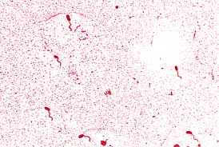
GENUS: VIBRIOS.
. Actively motile, gram-negative curved rods.
. Species of medical importance: Vibrio cholerae-01,Vibrio cholera.
Characteristics:
. Found in fresh water, shellfish and other sea food.
. Man is the major reservoir of V. cholerae-01, which causes epidemic cholera.
. Readily killed by heat and drying; dies in polluted water but may survive in clean stagnant water, esp. if alkaline, or sea water for 1-2 weeks.

Slide 3
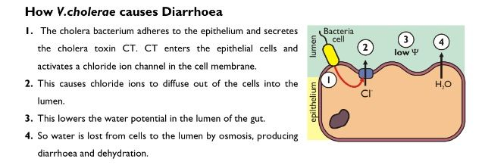
Clinical features:
Route of infection is fecal-oral route.
After ingestion of the V.cholerae-01, the bacteria adheres to the intestinal wall with out invasion then produces an exotoxin causing excessive fluid secretion and diminished fluid absorption resulting in diarrhea (rice water stool) which is characterized by passage of voluminous watery diarrhea containing vibrios, epithelial cells and mucus; and result in severe dehydration.

Slide 4
Laboratory diagnosis:
Specimen: Stool flecks.
Smear: Gram-negative motile curved rods.
Motility of vibrios is best seen using dark-field microscopy.
Presumptive diagnosis:
Inactivation of vibrios in a wet preparation after adding vibrio antiserum.
Culture:
1. TCBS (thiosulphate citrate bile salt sucrose agar) media Selectivemedia for primary isolation of V.cholerae.
. Observe for large yellow sucrose-fermenting colonies after 18-24
hrs of incubation.
2. Alkaline peptone water: Enrichment media for V.cholerae-01.
Growth on and just below the surface of peptone water with in 4-6 hours at room temperature as well as 37 o

Slide 5
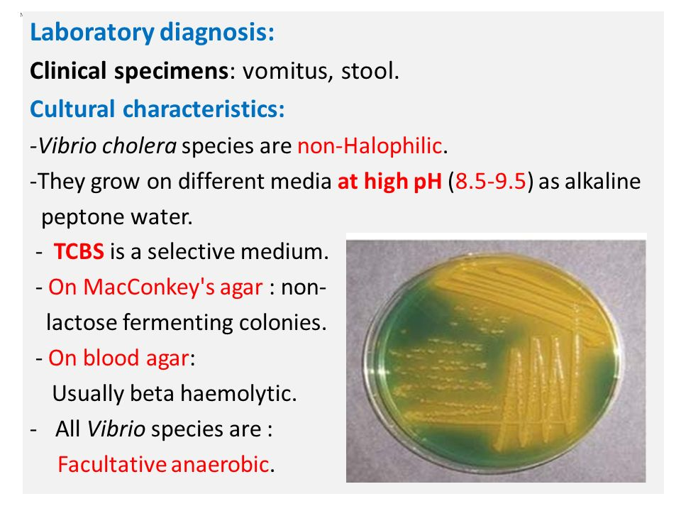

Slide 6
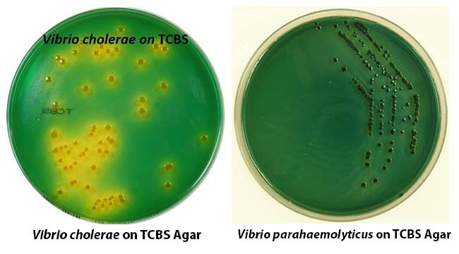

Slide 7
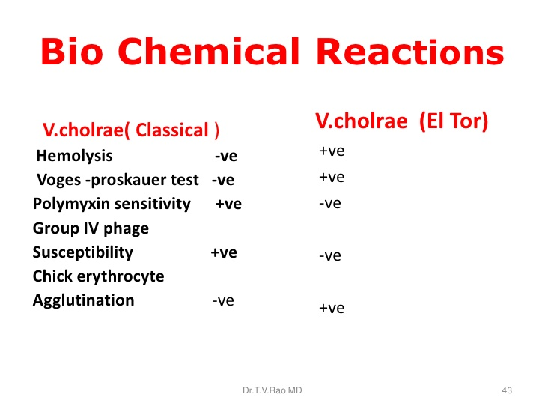
Biochemical Reaction:
oxidase-positive.
. Ferment sucrose and maltose(acid; no gas).
. Do not ferment L-arabinose.

Slide 8
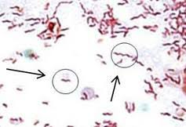
GENUS: CAMPYLOBACTER.
Characteristics:
Small, delicate, spirally curved gram-negative bacteria.
. Motile bacteria with single polar flagellum.
. Stricly microaerophilic bactria requiring 5-10% o2 and 10%
co2 enriched environment.
. Oxidase and catalase positive
S or ‘gull-wing’ shapes.

Slide 9
Species of medical importance:
Campylobacter jejuni
Campylobacter coli
Campylobacter jejuni and Campylobacter coli
Characteristics:
. Gram-negative non-spore forming motile rods with comma, S or ‘gull-wing’ shapes.
. Requires selective media like skirrow’s and Butzler’s media for isolation of the bacteria from faecal specimen.
Clinical features:
Inoculum dose: 104 organisms.
Source of infection is contaminated food, drinks,and unpasteurized milk.
The organism multiply in small intestine, invade the epithellium and produce inflammation.

Slide 10
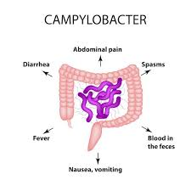
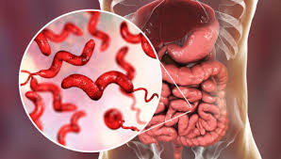
Campylobacter enteritis manifests with fever,headache, malaise, crampy abdominal pain and bloody mucoid diarrhea, and usually self-limited
enteritis in a week period.
Campylobacter infection.

Slide 11
Laboratory diagnosis:
Specimen: Stool.
Microscopy: Typical ‘gull-wing’ shaped gram-negative rods.
Typical darting motility of the bacteria under dark field microscopy or
phase contrast microscopy.
Culture: Grow best at 420c on selective media but can be cultured at 37 °C.
Watery and spreading or round and convex colonies on solid media at low oxygen tension.
Biochemica;l reaction:
C jejuni ……………….. hydrolyzes hippurate.
C. coli ……………… does not hydrolyze hippurate.

Slide 12
Helicobacter pylori.
General characteristics:
. Spiral-shaped gram negative, microaerophilic,motile rods with polar flagella.
Pathogenesis and clinical features:
Route of entry: Ingestion of contaminated food and drinks.
Familial clustering of H. pylori infection occurs.
. Type B chronic antral gastritis.
. Peptic ulcer disease (gastric and duodenal ulcer).
. Gastric carcinoma.
. Gastric lymphoma.
Lab. Diadnosis:
Specimen: Gatric biopsy, serum.
Smear: Giemsa or silver stain.
Culture: Skirrow’s media.
Tanslucent colonies after 7 days of incubation.

Slide 13
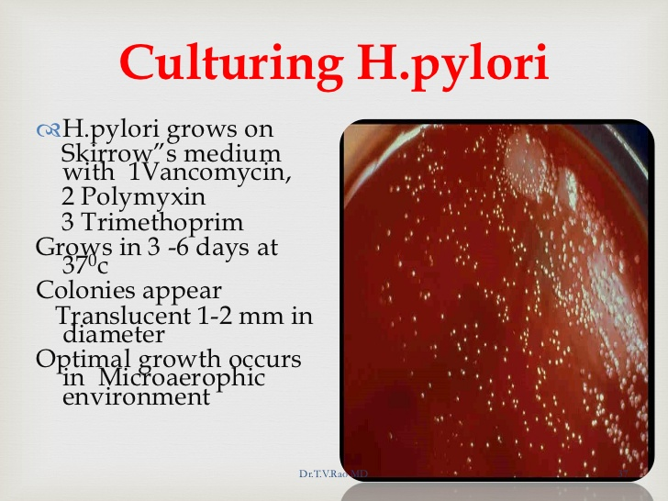
Biochemical reaction:
. Catalase positive.
. Oxidase positive.
. Urease positive.
Serology:
. Detection of antibodies in the serum specific for H. pylori.
. Detection of H. pylori antigen in stool specimen.

Slide 14
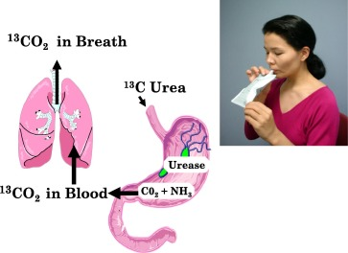
Special tests:
. Urea breath test.
The urea breath test (UBT) is a test for diagnosing the presence of abacterium, Helicobacter pylori (H. pylori) infection in the stomach. H. pylori causes inflammation, ulcers, and atrophy of the stomach. The test also may be used to demonstrate that H. pylori has been eliminated by treatment with antibiotics.
urea breath test.

Slide 15
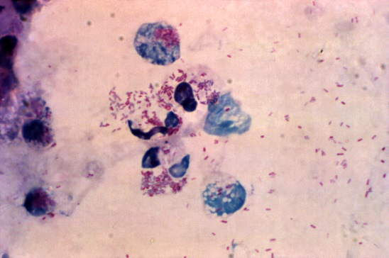
GENUS: LEGIONELLA.
L. pneumophila.
General characteristics:
Fastidious, aerobic, gram negative intracellular rods ,Ubiquitous in warm moist environment.

Slide 16
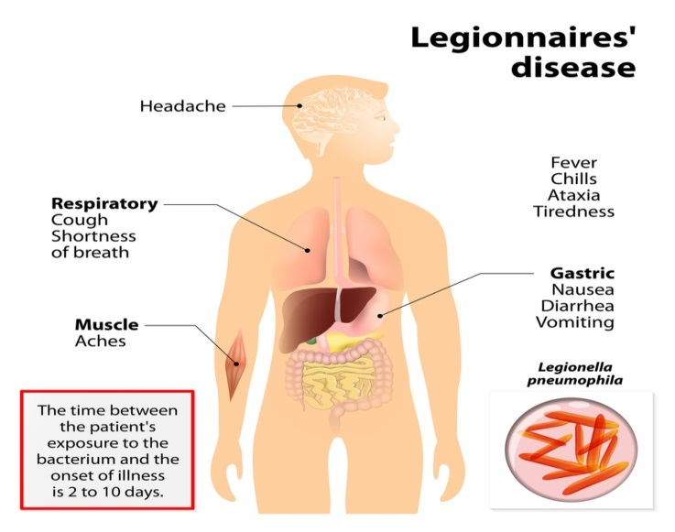
Pathogenesis and clinical features:
Route of transmission: Inhalation of aerosols generated from contaminated cooling towers, heat exchange apparatus, shower water, tap water, and potable water following chlorination.
1. Legionnaires disease: Pneumonic presentation with high fever, chills, dry cough, hypoxia, diarrhea, and altered mentation.
2. Pontial fever: Fever, chills, malaise, headache, malaise, altered mentation.

Slide 17
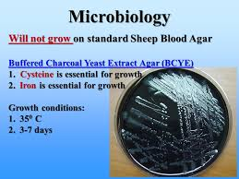
Laboratory diagnosis:
Specimen: Bronchial washing, Lung biopsy, Blood.
Smears: DFA (direct flourescent antibody) staining silver staining.
Cuture: Grow in BCYE (buffered charcoal-yeast extract) agar media.

Slide 18
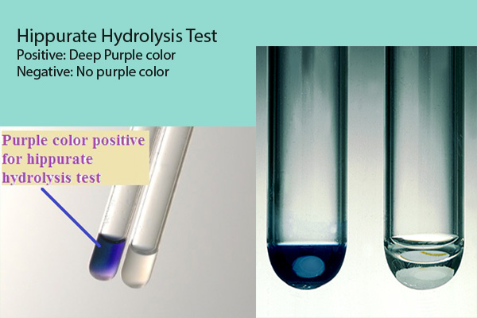
Biochemical tests:
Catalase positive ,Oxidase positive ,Hydrolyse hippurate.
Serologic testing: Useful in the diagnosis of retrospective outbreaks of legionella infection.

Slide 19


